Slide 1
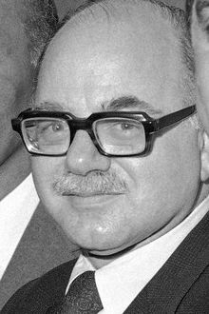
Daniel Bell
1919 – 2011, Harvard, Sociologist

Slide 2
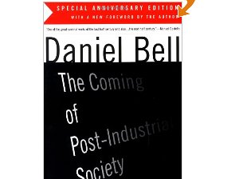
The Coming of Post-Industrial Society 1973/1976

Slide 3
 | Pre-industrial society | Industrial society | Post-industrial or information society
1 | Extractive industry: agriculture, mining, forestry or fishing. | Goods Production based on machine technology. | Services: transportation, utilities, trade, finance, health-care, education, arts, research, government,
2 | Raw Materials and natural power: wind, water, animal and human muscle. | Financial Capital and Created energy: coal, electric, oil, | Information, theoretical knowledge and computer
3 | Struggle with nature. | Struggle with fabricated nature. | Relations between people
4 | Crafts and skills: common sense, trial and error, and tradition. | Highly specific disciplines and engineering. | Integration of experimental sciences with cross-disciplinary methodology.

